Slide 1
What’s the state of HTML5 & hybrid apps?
Kevin Boyle

Slide 2


Kevin Boyle
http://www.kevinboyle.ie
@kevfromireland

Slide 3
Goal
Show you what hybrid apps have turned into over the last few years and what the state of play is in 2014*
*Hopefully show you that you can use HTML5 and
hybrid apps to solve a surprisingly wide workload.

Slide 4

Caveat
Always use what is most appropriate to your project!

Slide 5



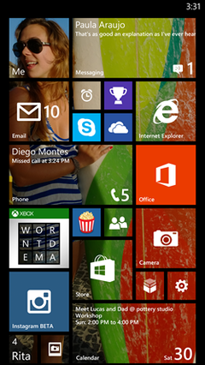
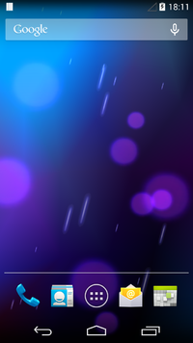
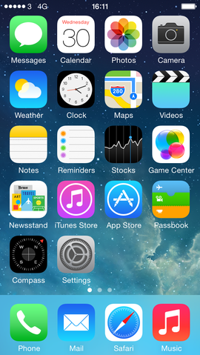

Slide 6

Native
iOS Libraries
Obj-C Business Layer
iOS Interface Builder
Android
Android Libraries
Java Business Logic
iOS
Android XML
Windows Phone
.NET
C# Business Logic
XAML

Slide 7
Native (Advantages)
Supported tool chain
Performance
Look and feel
App store submission

Slide 8
Native (Disadvantages)
Duplicated code
Languages
Platforms
Heavy maintenance cost

Slide 9

Target common language

Slide 10
Xamarin
Common C# Business
Interface Builder
Android XML
XAML
Android
Windows Phone
Xamarin.Android
.NET
iOS
Xamarin.iOS

Slide 11
Xamarin (Advantages)
Same advantages as native
Fewer languages
Fewer environments (for big parts of your code)
Reuse existing skills

Slide 12
Xamarin (Disadvantages)
Still duplicated code
With all those problems
Still need to train
Proprietary toolchain

Slide 13





Hybrid Apps

Slide 14
Old Cordova
Cordova JavaScript API
App Business Logic (JS
App UI (HTML
Your app
JS Bindings
iOS
Android
Windows Phone
Heavy Java App
Heavy Objective-C App
Heavy C# App
Native code to expose device features
Device

Slide 15
Cordova Architecture
Cordova JavaScript API
App Business Logic (JS
App UI (HTML
Your app
JS Bindings
iOS
Android
Windows Phone
GPS
Geolocation
Storage
SQLite
GPS
Storage
Geolocation
SQLite
GPS
Storage
Geolocation
SQLite
Native code to expose device features
Device

Slide 16
Demo: Cordova Plugins

Slide 17
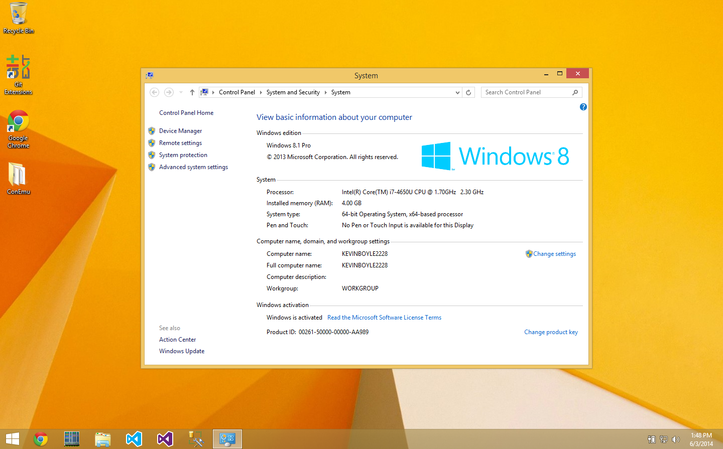
Hybrid apps on desktop?

Slide 18

Chromium Embedded

Slide 19
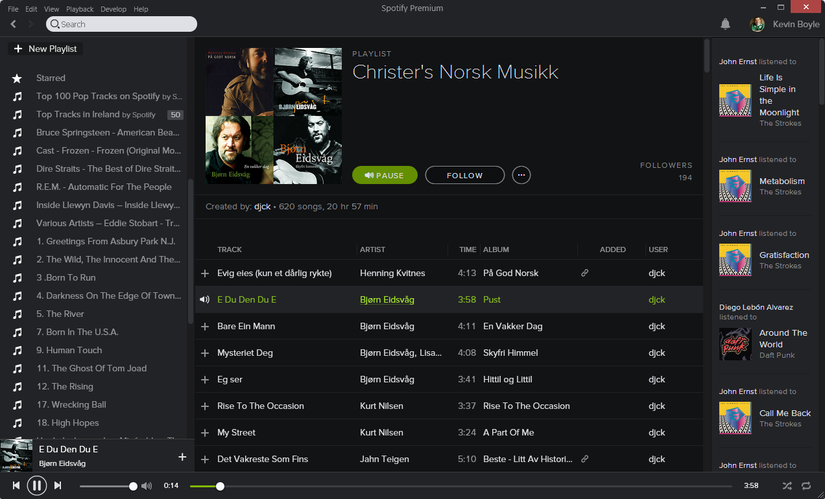


Slide 20
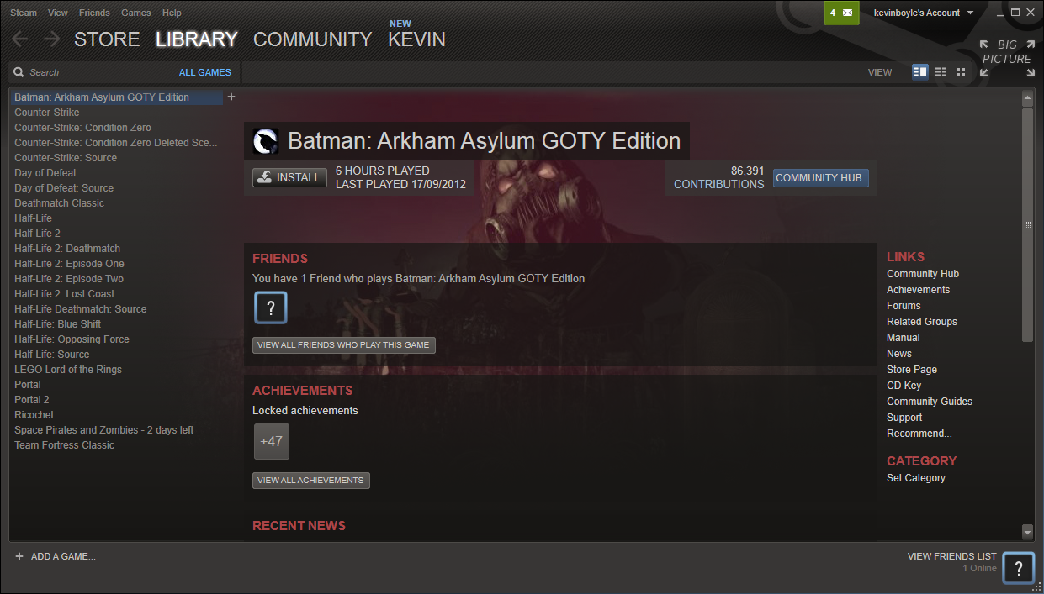


Slide 21

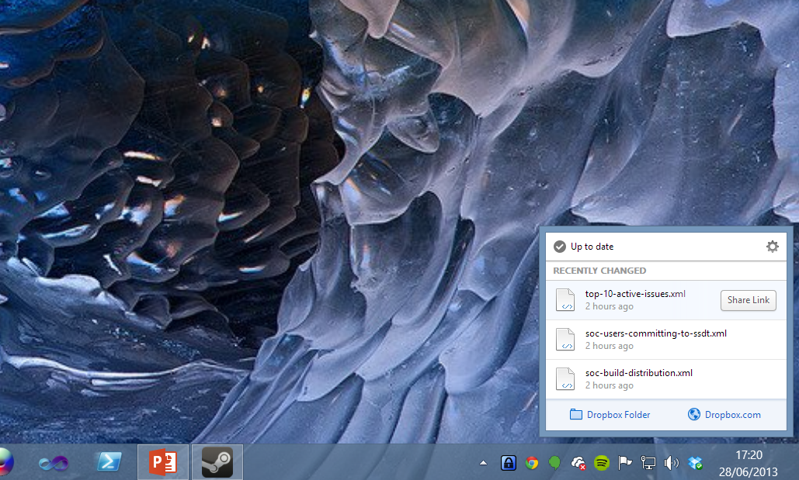

Slide 22
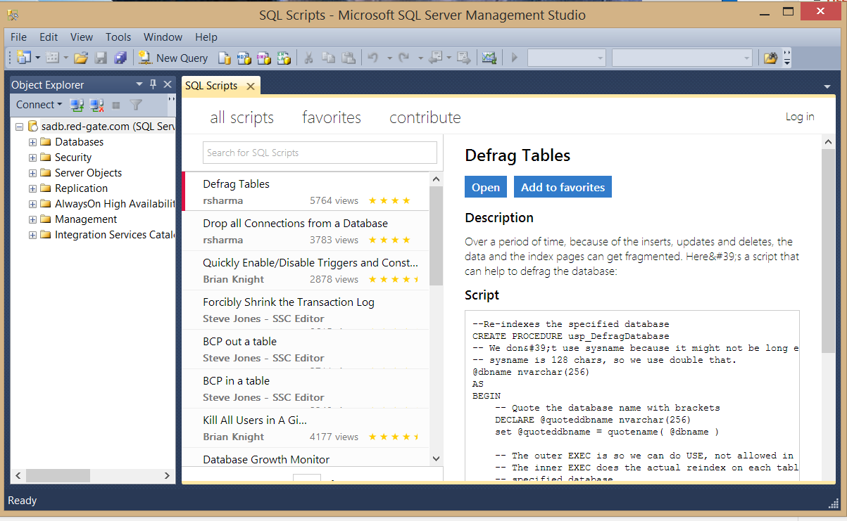
SQL Scripts

Slide 23
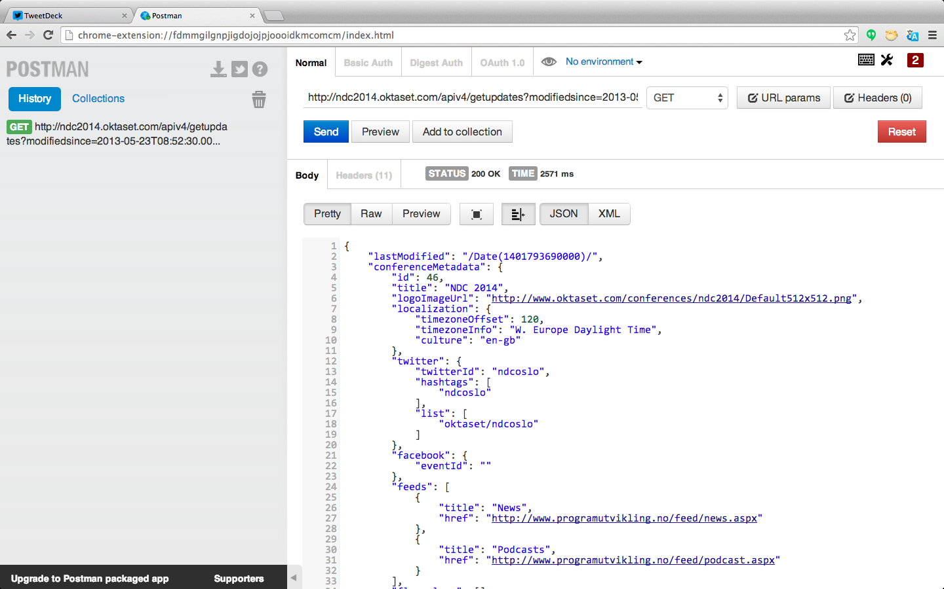
Chrome Packaged Apps

Slide 24
Hybrid (Advantages)
Code sharing
Transferrable skills
Pace of change
Future skills

Slide 25
Hybrid (Disadvantages)
Performance
Look and feel
Fragmented platform

Slide 26
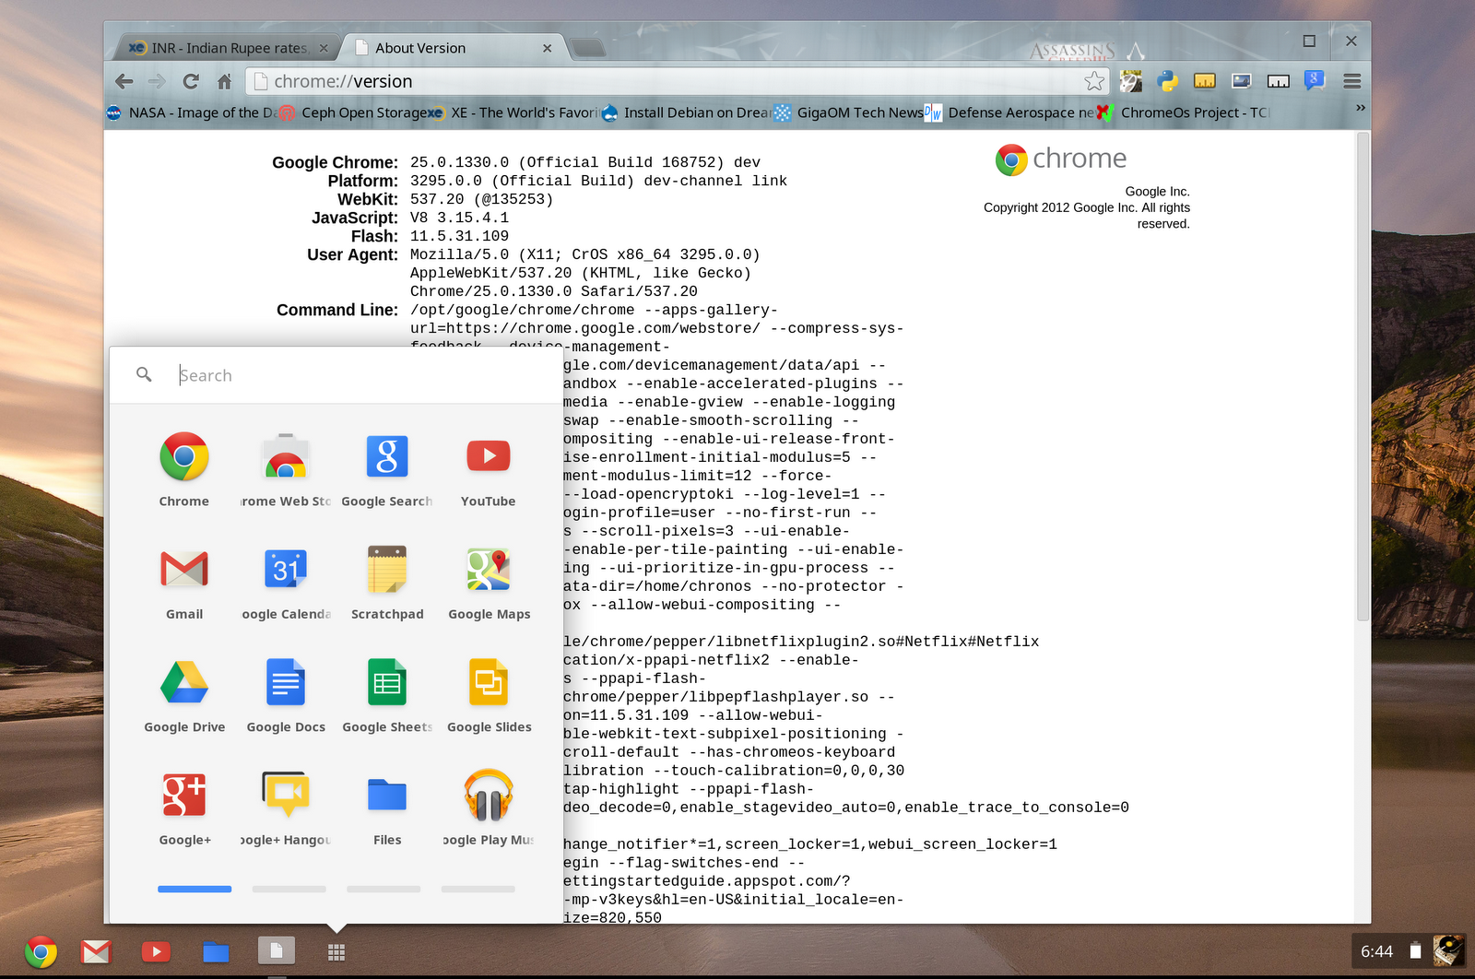
What is in the future?

Slide 27
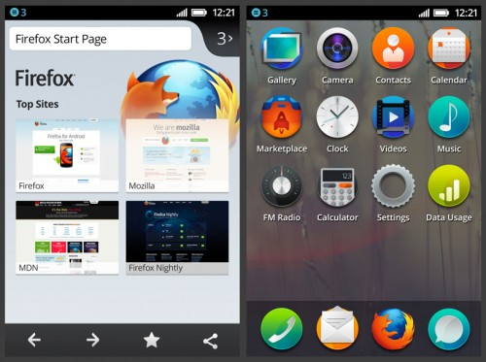
Firefox OS

Slide 28
(Chrome/Firefox) OS Architecture
Apps (HTML5)
Contacts
Settings
NFC
Bluetooth
System XHR
Camera
Media
Sensors
Chromium/Gecko
Radio
GPS
Power Management
USB
Touch
Filesystem
WiFi
Camera
Linux Kernel
OEM drivers

Slide 29
Review
Hybrid apps have matured
Hybrid apps aren’t restricted to mobile
They won’t fit all projects, but they fit more today than they ever have and the future is bright

Slide 30
Thanks*
*Double thanks if you leave some feedback!
@kevfromireland

